Slide 1
Materialize
Jaylen bain, Allyssa Taffe, Aubrey sutton

Slide 2


What is Materialize
Materialize CSS is a responsive front-end framework based on Material Design, which was developed by Google. Material Design is a design language that combines the classic principles of successful design along with innovation and technolog

Slide 3

Why Materialize
You might choose Materialize CSS for its:
1. Ease of Use: Pre-built components and a grid system make it easy to design websites.
2. Design Aesthetic: Follows Material Design principles, providing a modern and clean design aesthetic.
3. Responsiveness: Ensures your website is mobile-friendly and looks good on all screen sizes.
4. Comprehensive Documentation: Offers well-documented examples and guidelines, facilitating the learning curve for developers.
5. Community and Support: Popular among developers, providing a supportive community and plethora of resources.

Slide 4

Key feature
Key feature of materialize

Slide 5

prebuilt component
Consistency in Design: Ensuring a unified and consistent look and feel across the entire application by adhering to Material Design principles.
Efficiency: Enabling developers to create aesthetically pleasing and functional UIs quickly without having to code common elements from scratch.
Usability: Enhancing user experience with familiar UI patterns, aiding in navigation and interaction within the application.
Responsiveness: Ensuring the UI components adapt gracefully across various screen sizes and orientations, providing a smooth user experience.
Customizability: Allowing developers to easily modify and adapt components to suit specific design needs while maintaining coherence in UI.

Slide 6
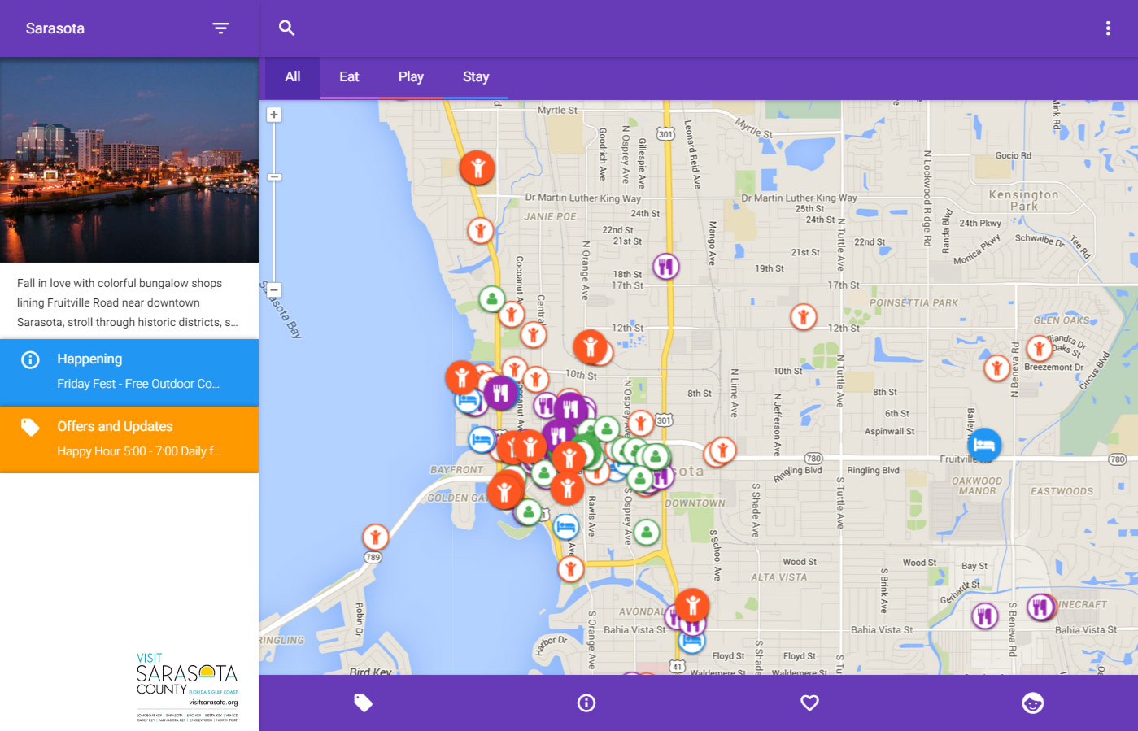
This is a example of a website example with materialize

Slide 7
Takeways
Unified and Consistent Design
Leverage Google's Material Design principles for a coherent user interface and experience.
Efficiency and Rapid Development
Utilize a multitude of prebuilt components to accelerate the development process and ensure robust functionality.
Responsiveness Ensured
Achieve optimal viewing and interaction experiences across a range of devices with Materialize CSS’s adaptive capabilities.
User-Friendly Experience
Enhance user interaction and satisfaction with an intuitive and predictable design system.
Supportive Developer Community
Engage with and leverage the extensive Materialize CSS community and resources for continuous learning and support.
President
Chief Executive Officer
Chief Operations Officer
VP Marketing

Slide 8
Q&A
Open the floor for any questions and further discussion
President
Chief Executive Officer
Chief Operations Officer
SEO Strategis

Slide 9
THANK YOU

